Slide 1

CS212: Object-Oriented Programming
Control Structures
Instructor: Hirra Anwar

Slide 2
Control Structures in Java
We learn about Control Structures
Structured-programming principle
Control structures help build and manipulate objects
Program control
Specifying the order in which actions execute
Control structures help specify this order

Slide 3
Control Structures
Sequential execution
Program statements execute one after the other
Transfer of control
Three control statements can specify order of statements
Sequence structure
Selection structure
Repetition structure

Slide 4
Control Structures
Flowchart
Graphical representation of algorithm
Flowlines indicate order in which actions execute

Slide 5
Flowchart Example
Flowlines
Action Symbols
add grade to total
total = total + grade;
add 1 to counter
counter = counter +
1
;
Connector Symbols
Fig 1: Flowcharting Java’s sequence structure.

Slide 6
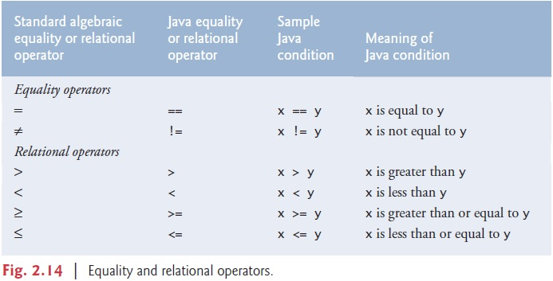
Equality & Relational Operators

Slide 7
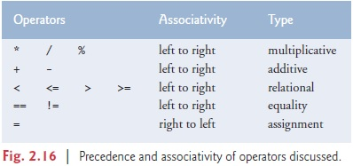
Equality & Relational Operators

Slide 8
Control Structures
Java has a sequence structure “built-in”
Java provides three selection structures
if
if/else
Switch
Java provides three repetition structures
while
do/while
for

Slide 9
Control Structures
The if Selection Structure
Single-entry/single-exit structure
Perform action only when condition is true
Action/decision programming model

Slide 10
Control Structures
The if Selection Structure
Decision Symbol
true
grade >= 60
print “Passed”
false
Fig 2: Flowcharting the single-selection if structure.

Slide 11
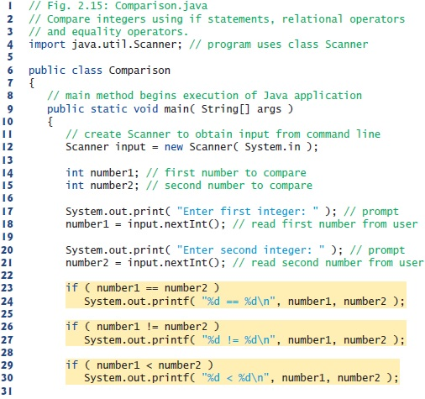



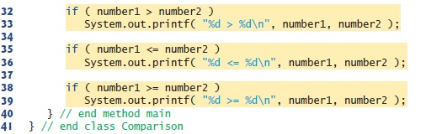

Slide 12
Control Structures
The if/else Selection Structure
Perform action only when condition is true
Perform different specified action when condition is false

Slide 13

Control Structures
The if/else Selection Structure
false
true
grade >= 60
print “Failed”
print “Passed”
Fig 3: Flowcharting the double-selection if/else structure.

Slide 14
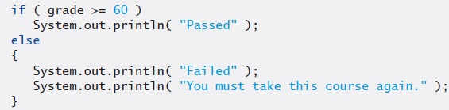
Control Structures
Blocks
The if statement normally expects only one statement in its body
To include several statements in the body of an if (or the body of an else for an if…else statement), enclose the statements in braces
Statements contained in a pair of braces form a block

Slide 15
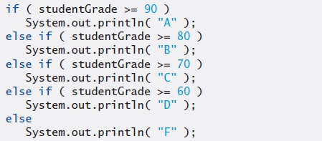
Control Structures
Nested if…else Statements
A program can test multiple cases by placing if…else statements inside other if…else statements

Slide 16
Common Programming Error
Placing a semicolon after the condition in an if or if…else statement leads to a logic error in single-selection if statements and a syntax error in double-selection if…else statements (when the if-part contains an actual body statement).

Slide 17
Conditional Operator (?:)
An alternative to if/else statement
Java’s only ternary operator (operator that takes three operands)
Example:
System.out.println( studentGrade >= 60 ? "Passed" : "Failed" );

Slide 18
Control Structures
while Repetition Statement
Repeat action while a condition remains true
true
product <= 100
product = 3 * product
false
Fig 4: Flowcharting the while repetition structure.

Slide 19
Common Programming Error
Not providing in the body of a while statement an action that eventually causes the condition in the while to become false normally results in a logic error called an infinite loop (the loop never terminates).

Slide 20
Counter-Controlled Repetition
Counter
A variable that controls number of times a set of statements executes
Example case study
A class of ten students took a quiz. The grades (integers in the range 0 to 100) for this quiz are available to you. Determine the class average on the quiz.

Slide 21
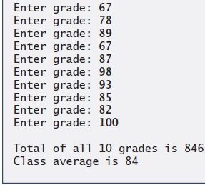
Counter-Controlled
Repetition
01 // Importing the Scanner class
02 import java.util.Scanner;
03
04 public class Average1
05 {
06 // main method begins execution of Java application
07 public static void main( String args[] )
08 {
09 int total, // sum of grades input by user
10 gradeCounter, // number of grades entered
11 gradeValue, // grade value
12 average; // average of all grades
13
14 // Initialization Phase
15 total = 0; // clear total
16 gradeCounter = 1; // prepare to loop
17 Scanner input = new Scanner(System.in);
18
19 // Processing Phase
20 while ( gradeCounter <= 10 ) // loop 10 times
21 {
22 // prompt for input and read grade from user
23 System.out.print("Enter grade: ");
24 gradeValue = input.nextInt( );
25
26 // add gradeValue to total
27 total = total + gradeValue;
28
29 // add 1 to gradeCounter
30 gradeCounter = gradeCounter + 1;
31 }
32 average = total/10; // Compute average & display result
33 System.out.printf(“Total of all 10 grades is %d\n", total);
34 System.out.printf(“Class average is %d\n", average);
35 }
36 }
Declare variables; gradeCounter is the counter
Continue looping as long as gradeCounter is less than or equal to 10

Slide 22
Sentinel-Controlled Repetition
Sentinel value
Used to indicated the end of data entry
E.g., User enters sentinel value (-1) to end repetition
Often called an indefinite repetition
Example case study
Develop a class-averaging program that processes grades for an arbitrary number of students each time it’s run.

Slide 23
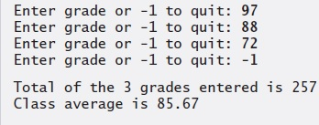
Sentinel-Controlled Repetition
01 import java.util.Scanner;
02 public class Average2
03 {
04 // main method begins execution of Java application
05 public static void main( String args[] )
06 {
07 int total, gradeCounter, gradeValue;
08 double average;
09
10 // Initialization Phase
11 total = 0;
12 gradeCounter = 0;
13 Scanner input = new Scanner(System.in);
14
15 // prompt for input and read grade from user
16 System.out.print("Enter grade or -1 to quit: ");
17 gradeValue = input.nextInt( );
18
19 // Processing Phase
20 while (gradeValue != -1 )
21 {
22 total = total + gradeValue;
23 gradeCounter = gradeCounter + 1;
24
25 // prompt for input and read grade from user
26 System.out.print("Enter grade or -1 to quit: ");
27 gradeValue = input.nextInt( );
28 }
29 if (gradeCounter != 0 )
30 {
31 average = (double) total / gradeCounter; // Compute average & display
32 System.out.printf(“Total of the %d grades entered is %d\n", gradeCounter, total);
33 System.out.printf(“Class average is %.2f\n", average);
34 }
35 else System.out.println(“Please enter valid grades");
36 }
37 }
loop until gradeValue equals sentinel value (-1)

Slide 24
Compound Assignment Operators
Abbreviate assignment expressions
Any statement of form
variable = variable operator expression;
Can be written as
variable operator= expression;
E.g., addition assignment operator +=
c = c + 3;
Can be written as
c += 3;

Slide 25
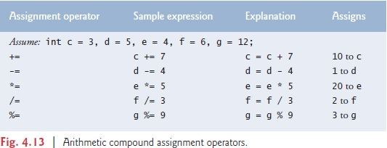
Compound Assignment Operators

Slide 26
Increment & Decrement Operators
Unary increment operator (++)
Increment variable’s value by 1
Unary decrement operator (--)
Decrement variable’s value by 1
Pre-increment / pre-decrement operator
Post-increment / post-decrement operator

Slide 27
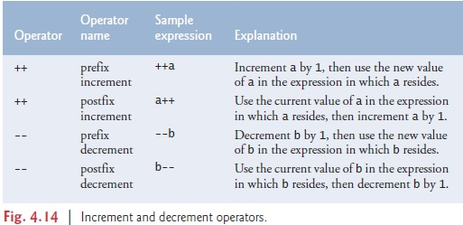
Increment & Decrement Operators

Slide 28
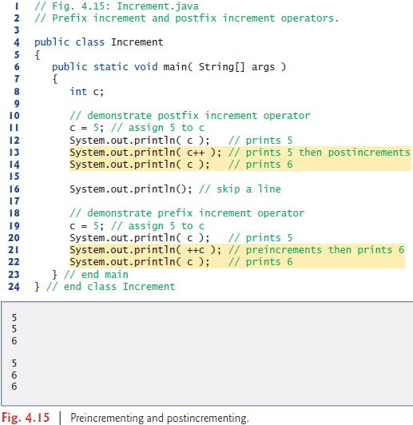

Slide 29
Common Programming Error
Attempting to use the increment or decrement operator on an expression other than one to which a value can be assigned is a syntax error. For example, writing ++(x + 1) is a syntax error, because (x + 1) is not a variable.

Slide 30
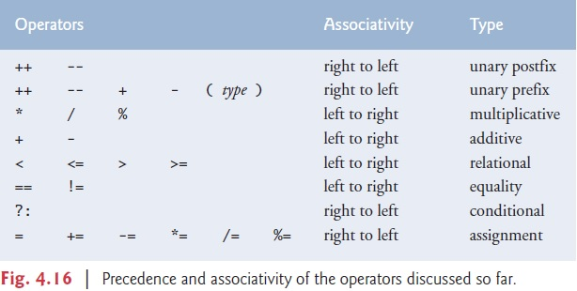

Slide 31
Primitive Data Types
Primitive types
“building blocks” for more complicated types
Java is strongly typed
All variables in a Java program must have a type
Java primitive types
portable across computer platforms that support Java

Slide 32
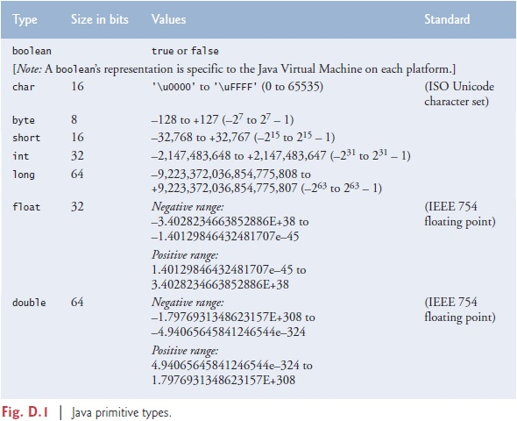

Slide 33
Essentials of Counter-Controlled Repetition
Counter-controlled repetition requires:
Name of control variable (loop counter)
Initial value of control variable
Increment/decrement of control variable through each loop iteration
Condition that tests for control variable’s final value

Slide 34
Counter-Controlled Repetition
The for Repetition Structure
for
Control variable
Final value
keyword
name
of control variable
for (
int
counter =
1
; counter <=
10
; counter++ )
Initial value
Increment
of control variable
of control variable
Loop-continuation condition
Fig. 5: Components of a typical for structure header.

Slide 35
Counter-Controlled Repetition
The for Repetition Statement
Establish
int counter = 1
initial value
of control variable.
Determine if
true
final value
counter <= 10
Print counter
counter++
of control
Increment
variable has been
the control
reached.
false
Body of loop
variable.
(this may be many
statements)
Fig. 6: Flowcharting a typical for repetition structure.

Slide 36
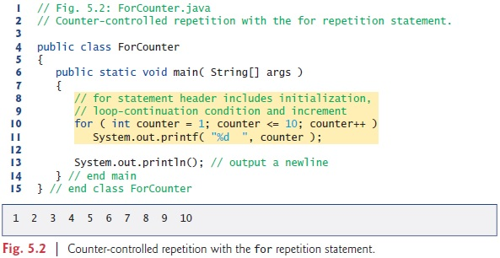
Counter-Controlled Repetition

Slide 37
Counter-Controlled Repetition
for(expression1; expression2; expression3) statement;
Can usually be written as:
expression1; while ( expression2 )
{ statement; expression3; }

Slide 38
Examples Using the for Structure
Varying control variable in for structure
Vary control variable from 1 to 100 in increments of 1
for ( int i = 1; i <= 100; i++ )
Vary control variable from 100 to 1 in decrements of –1
for ( int i = 100; i >= 1; i-- )
Vary control variable from 7 to 77 in steps of 7
for ( int i = 7; i <= 77; i += 7 )

Slide 39
Control Structures
do…while Repetition Statement
Similar to the while structure
tests the loop-continuation condition after executing the loop’s body; therefore, the body always executes at least once
action(s)
true
condition
false
Fig. 7: Flowcharting the do/while repetition structure.

Slide 40
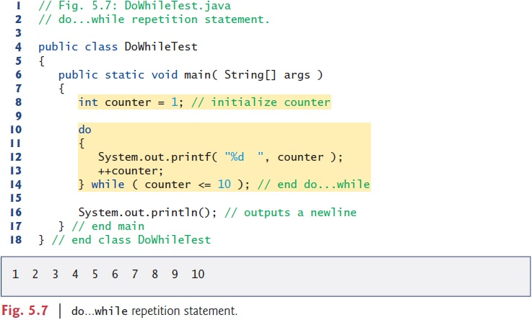
do…while Repetition

Slide 41
The switch Multiple-Selection Structure
switch structure
Used for multiple selections

Slide 42
The switch Multiple-Selection Structure
true
case a
case a action(s)
break
false
true
case b
case b action(s)
break
false
true
case z
case z action(s)
break
false
default action(s)
Fig. 8: The switch multiple-selection structure.

Slide 43
// Counting letter grades with switch.
import java.util.Scanner;
public class LetterGrades
{
public static void main( String args[] )
{
int total = 0; // sum of grades
int gradeCounter = 0; // number of grades entered
// no. of As, Bs, Cs
int aCount = 0, bCount = 0, cCount = 0, dCount = 0, fCount = 0;
Scanner input = new Scanner(System.in);
System.out.println("Enter the integer grades in the range of 0-100.");
System.out.println("Enter the -1 to terminate the input");
while ( input.hasNext() )
{
int grade = input.nextInt();
if(grade == -1)
break;
total += grade; // add grade to total
++gradeCounter;
switch (grade / 10) // switch nested in while
{
case 9: // grade was between 90
case 10:// and 100, both inclusive
++aCount;
break; // necessary to exit switch
case 8: // grade was between 80 and 89
++bCount;
break;
case 7: // grade was between 70 and 79
++cCount;
break;

Slide 44
case 6: // grade was between 60 and 69
++dCount;
break;
default: // grade was less than 60
++fCount;
break;
} // end switch
} // end while
System.out.println( "\nGrade Report:" );
// if user entered at least one grade...
if ( gradeCounter != 0 )
{
// calculate average of all grades entered
double average = (double) total / gradeCounter;
// output summary of results
System.out.printf( "Total of the %d grades entered is %d\n",
gradeCounter, total );
System.out.printf( "Class average is %.2f\n", average );
System.out.printf( "%s\n%s%d\n%s%d\n%s%d\n%s%d\n%s%d\n",
"Number of students who received each grade:",
"A: ", aCount, // display number of A grades
"B: ", bCount, // display number of B grades
"C: ", cCount, // display number of C grades
"D: ", dCount, // display number of D grades
"F: ", fCount ); // display number of F grades
} // end if
else // no grades were entered, so output appropriate message
System.out.println( "No grades were entered" );
} // end main
} // end class LetterGrades

Slide 45
The break Statement
Alter flow of control
Causes immediate exit from control structure
Used in while, for, do/while or switch statements

Slide 46
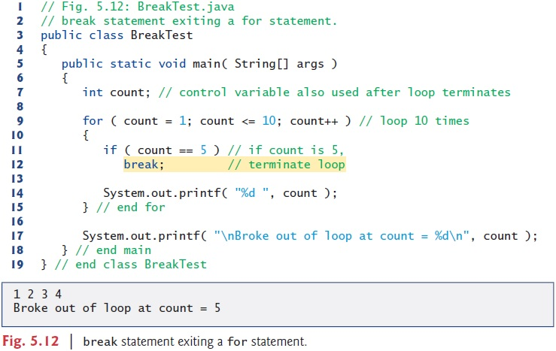
The break Statement

Slide 47
The continue Statement
Alter flow of control
Skips remaining statements in loop body
Proceeds to next iteration
Used in while, for, do/while statements

Slide 48
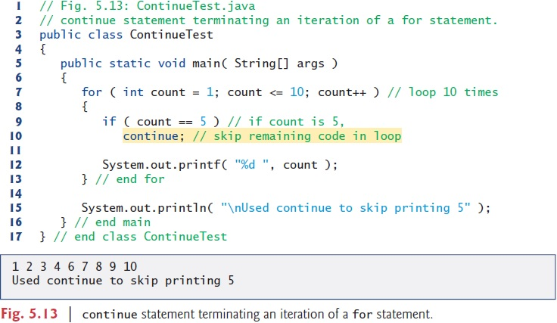
The continue Statement

Slide 49
Logical Operators
Allows for forming more complex conditions
Combines simple conditions
Java logical operators
&& (logical AND)
& (boolean logical AND)
|| (logical OR)
| (boolean logical inclusive OR)
^ (boolean logical exclusive OR)
! (logical NOT)

Slide 50
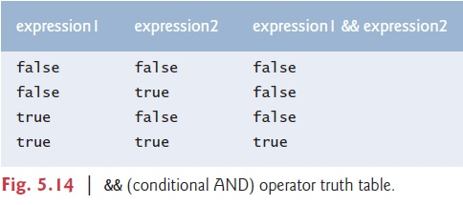
Logical Operators

Slide 51
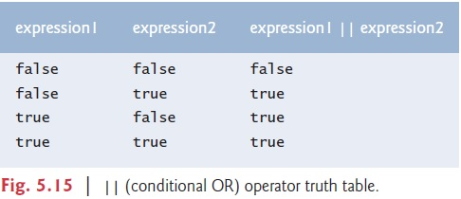
Logical Operators

Slide 52
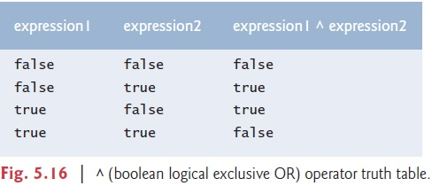
Logical Operators

Slide 53
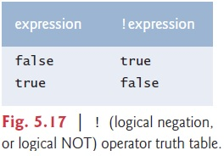
Logical Operators

Slide 54
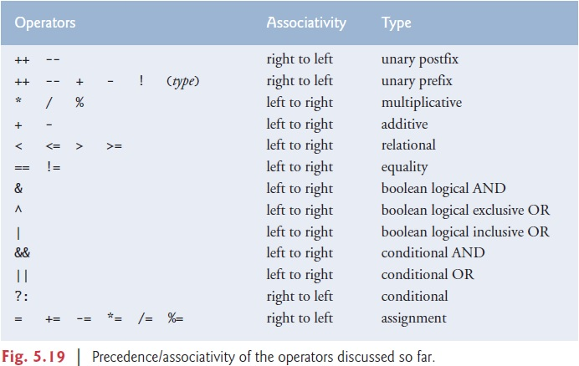

Slide 55
Questions/Answers &
Discussion

